Slide 1







IBM Data Analyst Capstone Project
Michael Ishak
<12/07/2022>

Slide 2



OUTLINE
Executive Summary
Introduction
Methodology
Results
Visualization – Charts
Dashboard
Discussion
Findings & Implications
Conclusion
Appendix

Slide 3


EXECUTIVE SUMMARY
Following Current Technology Usage
Language
Database
Platform
Web-frame
Future Technology Trend
Language
Database
Platform
Web-frame
Demographics Survey
Country & Gender Influences

Slide 4

INTRODUCTION
Analyse technology trend in software and web development among developers around the world
Purpose
Identify the top programming languages, database, platform and web frame skills in demand
Identify key skills for the future and the human resource gap in industry
Target Audience
Programmers
IT industry leaders

Slide 5

METHODOLOGY
Data Collection (Sources)
Stack overflow developer 2019 survey
GitHub job postings
Programming languages annual salary
Data Wrangling
Data Exploration
Data Cleaning
Data Visualization
Python matplotlib
IBM Cognos
Present Findings

Slide 6
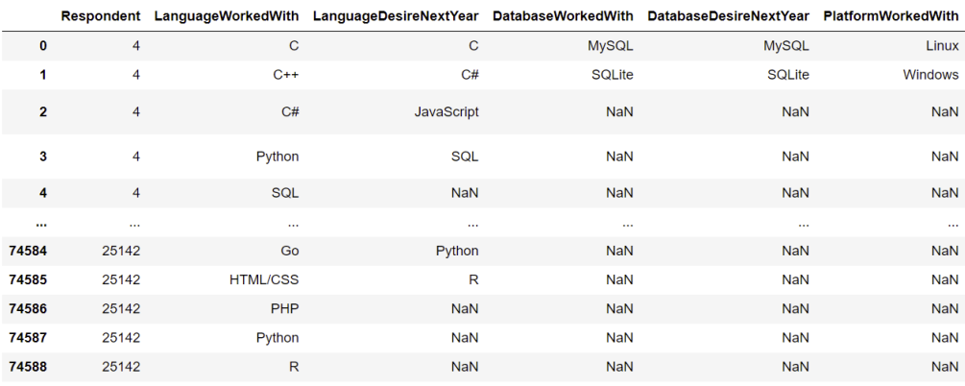
RESULTS

Slide 7
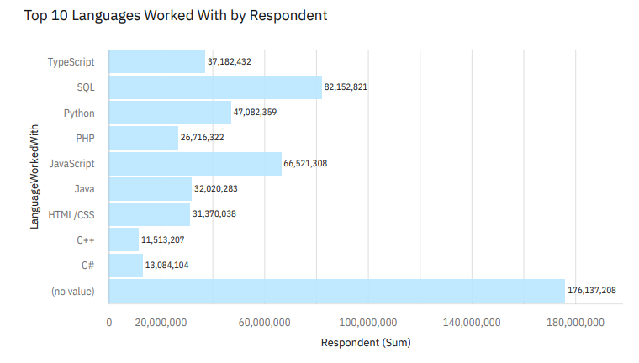
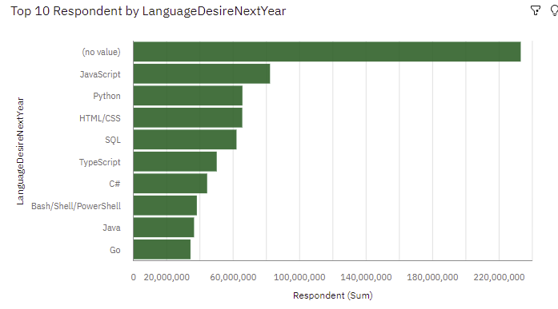
PROGRAMMING LANGUAGE TRENDS
Current Year
Next Year

Slide 8
PROGRAMMING LANGUAGE TRENDS - FINDINGS & IMPLICATIONS
Findings
JS is the top trending language worldwide
Python and TypeScript are becoming more popular
HTML/CSS and SQL control a large portion of language usage
Implications
Website developers are in high demand
JS and TypeScript are crucial to learn for developers
Python is the new trending language and is popular in AI fields

Slide 9
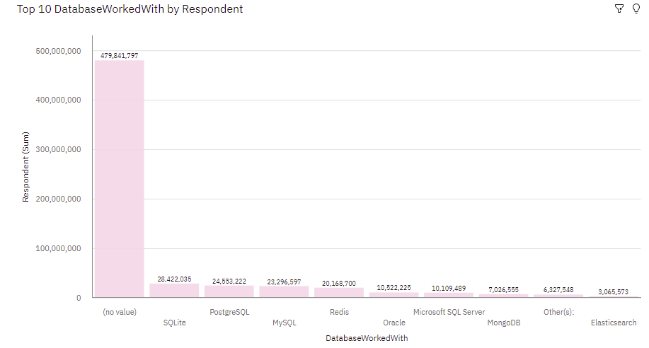
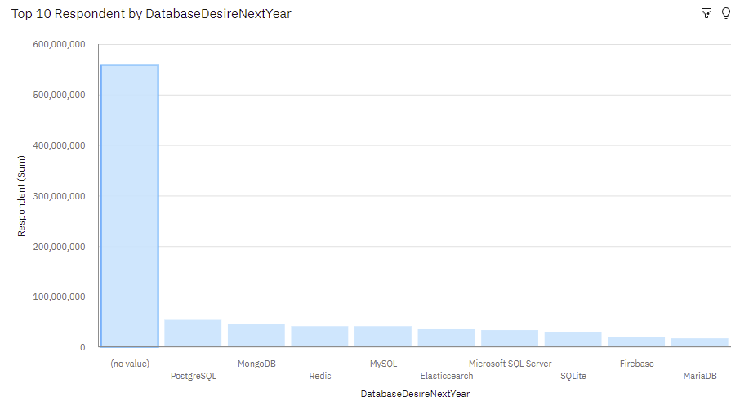
DATABASE TRENDS
Current Year
Next Year

Slide 10
DATABASE TRENDS - FINDINGS & IMPLICATIONS
Findings
MySQL is the most used database
Many companies still use Microsoft SQL Server
MongoDB and Redis are the most popular NoSQL database
Implications
Open-source databases are favoured
Big Data and Software Dev needs SQL
NoSQL impacts relational databases

Slide 11

DASHBOARD
Read-only view of Cognos Dashboard is linked:
https://eu1.ca.analytics.ibm.com/bi/?perspective=dashboard&pathRef=.my_folders%2FIBM%2BCapstone%2BProject&action=view&mode=dashboard&subView=model00000181f40f36b0_00000000

Slide 12
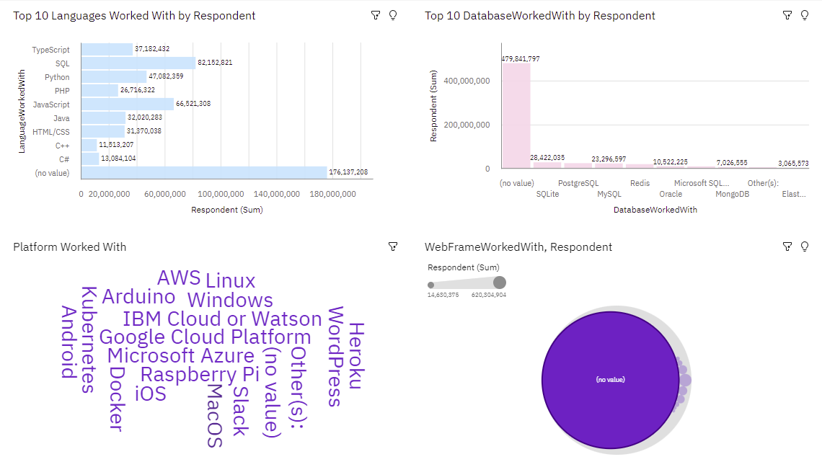
Current Technology Usage

Slide 13
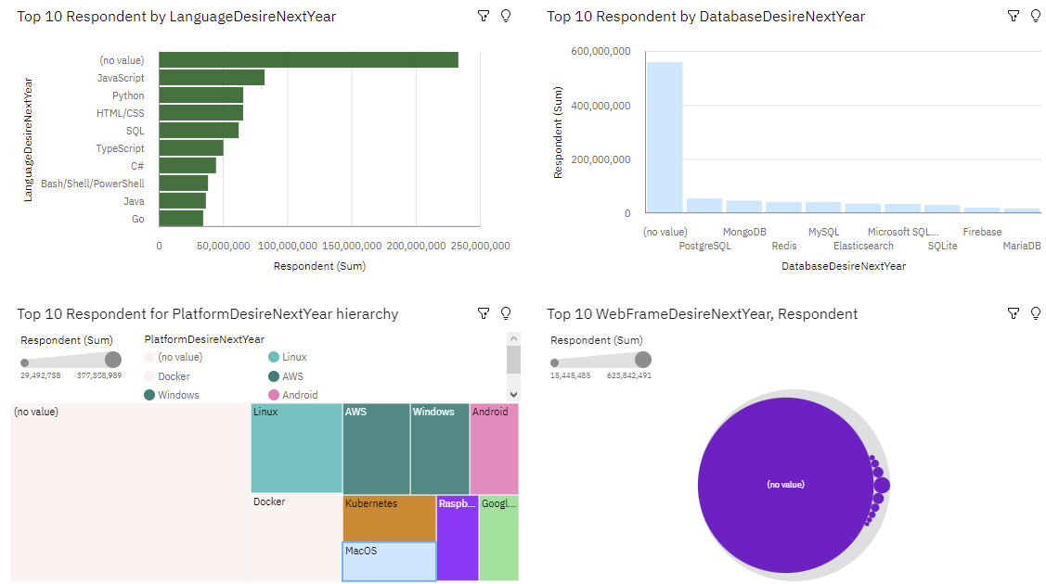
Future Technology Trend

Slide 14
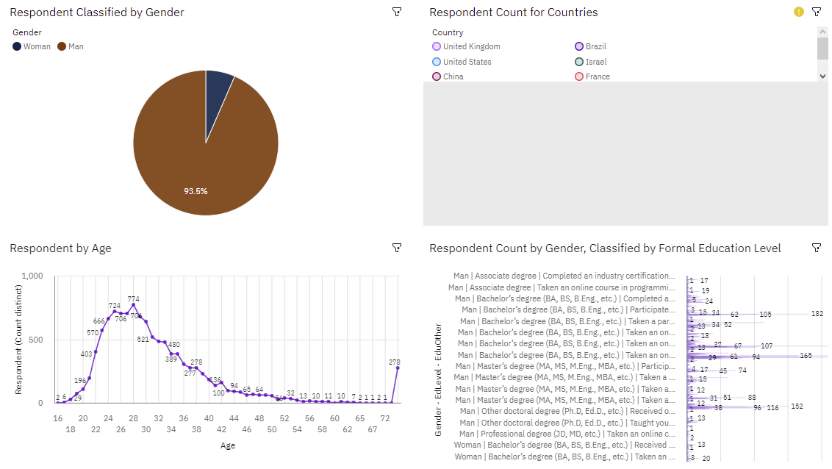
Demographics

Slide 15
DISCUSSION
Technology Usage Trend Now and Future
Gender, Age and Education Discrimination in the IT industry

Slide 16
OVERALL FINDINGS & IMPLICATIONS
Findings
Technology trends change every year
USA is the top technology country
There is extreme gender and age discrimination
Docker and AWS are the most popula
Implications
Programmers should always follow the latest technology trends
More countries should have the equal chance to be exposed to new technology
Gender and Age should not be one of the concerns or benefits of Employment

Slide 17

CONCLUSION
Technology Trends
Programming Languages, Database, Platform and Web frame Trends
Demographics Trends
Gender and Education
Programming Languages Trends and Salary Trends

Slide 18
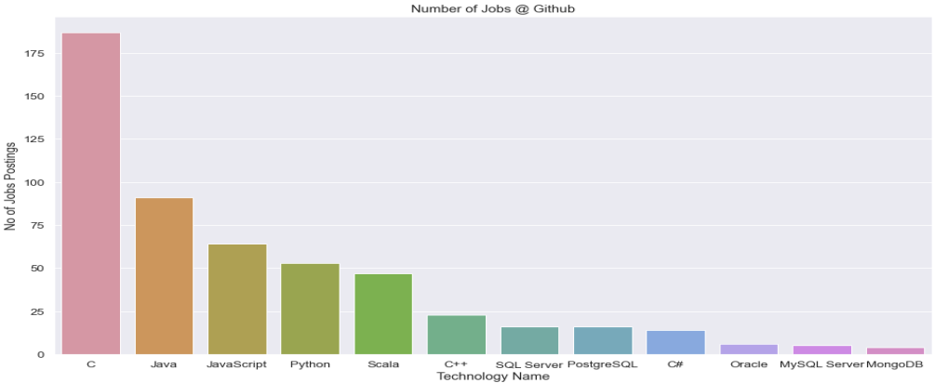
JOB POSTINGS
In Module 1 you have collected the job posting data using Job API in a file named “job-postings.xlsx”. Present that data using a bar chart here. Order the bar chart in the descending order of the number of job postings.

Slide 19
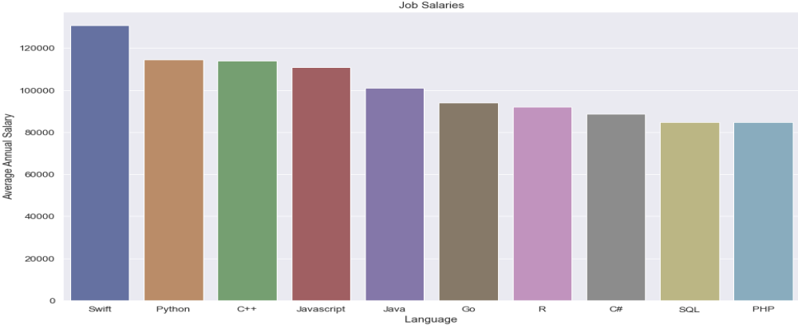
POPULAR LANGUAGES
In Module 1 you have collected the job postings data using web scraping in a file named “popular-languages.csv”. Present that data using a bar chart here. Order the bar chart in the descending order of salary.

